Slide 1
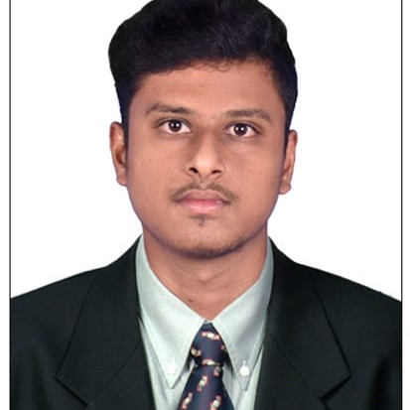
GANESH D
Analyst/Software Engineer
Bachelor of Technology
Electronics and Communication Engineering: 2018 - 2022
Skills Java 8
Spring Boot
Spring MVC
JPA CRUD
Rabbit MQ
Docker
MERN Stack
ReactJS
MongoDB
Database
MongoDB
Web Technologies
HTML5
CSS3
Javascript
AddOns
Github
Maven
Postman
Additional Details
Excellent Communication Skills
Time management
Mumbai
GANESH.DHETCHANAMOORTHI@CAPGEMINI.COM
+91 9840906199
A4
Software Engineer who has a lot of passion on Web Development, and always happy to implement new projects.
Ready to learn new technologies and implement them to further improve my knowledge.
Eager to work in a team of dedicated people and serve a key role in the enhancement and development of the project.
Having working Knowledge on Java, REACT, Microservices and Spring Framework.
Hotel Management System
Completed end to end case study of Hotel Management System Application using microservice architecture with spring boot along with Swagger and testing , MongoDB database and React used for user interface.
Completed the capgemini Adapt Java full stack react training

